Slide 1

Boeing Optimization Research Project
Michael Chan, Brandon To, Mike Truong
Group 45

Slide 2
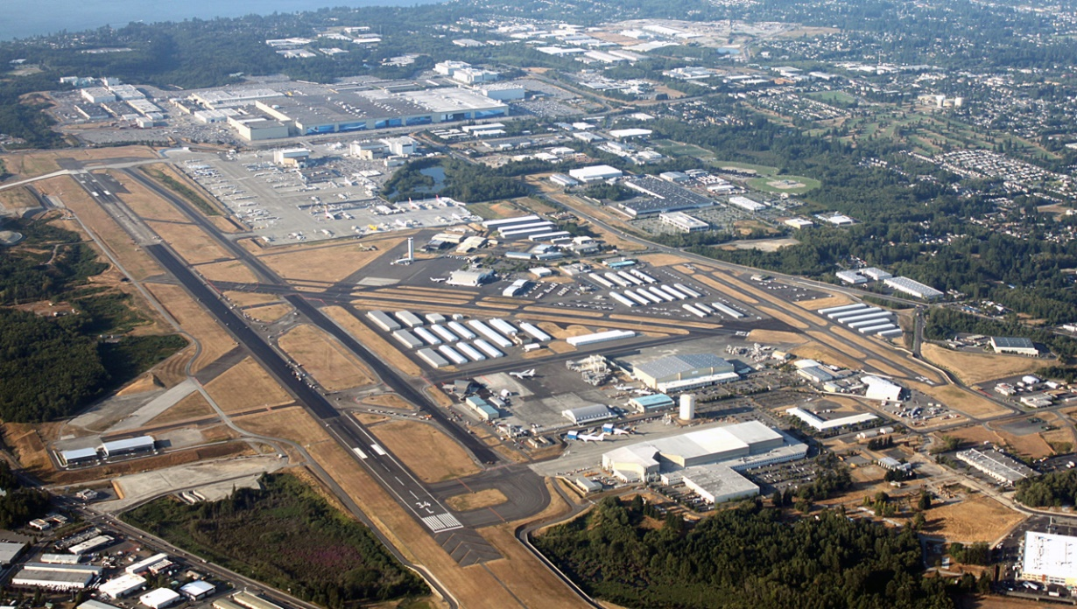
Purpose
Location: Boeing Everett Factory (Everett, WA)
Goal: Optimizing arrival and departure times of salaried employees
Minimize disruption to production

Slide 3
Proposed Solution
Design an algorithm
Series of suggestions
Deliverable: White Paper Recommendation
Primarily aimed for use by management team

Slide 4
Types of Data
Spatial
Temporal
Roads
Entrances
Preferred shift times and project groups
Main Variables

Slide 5
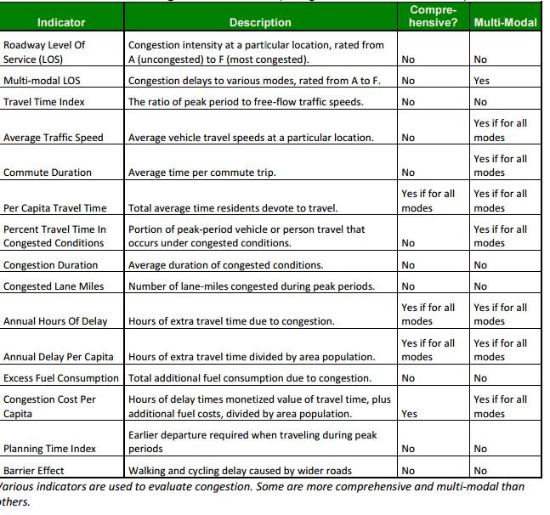
Source: Found at vtpi.org

Slide 6
Observational Techniques
Field Study
Survey (Optional)
Interviews
Traffic Surveying
Analyzing Facilities
Case Control Study
Comparing interests of employees

Slide 7
Development and Testing of the Solution
Development
Break down the activity of interest into steps and analyze them individually
Is an improvement possible or needed?
Testing
Agile style development
Looking at inputs and outputs
Have management implement our solutions
Pen and paper test

Slide 8
Current Progress
Drafted documents for requirements and goals
Awaiting NDA approval from client
Planning for trip to Everett, WA to conduct study

Slide 9
Problems
Cannot proceed to design algorithm without NDA approval
No documents from Boeing provided
Factors, Project Teams, Facilities Blueprints

Slide 10
Citations
[1]T. Litman, Smart Congestion Relief, 1st ed. Victoria: Victoria Transport Policy Institute, 2016, p. 12.

